Slide 1

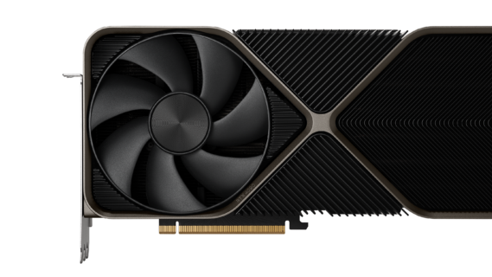


Sentiment Analysis
Danny Grozdev

Slide 2



My plan
Obtain all Nvidia’s 10Ks and 10Qs
Perform sentiment analysis using the VADER and stop words sentiment analyzer to get sentiment scores (pos, neu, neg, overall)
Merge the scores with dates and stock return data
Plot charts and find insights to determine if changes in negative sentiment can predict stock returns
Find additional insights using sentiment data
Form overall conclusion

Slide 3
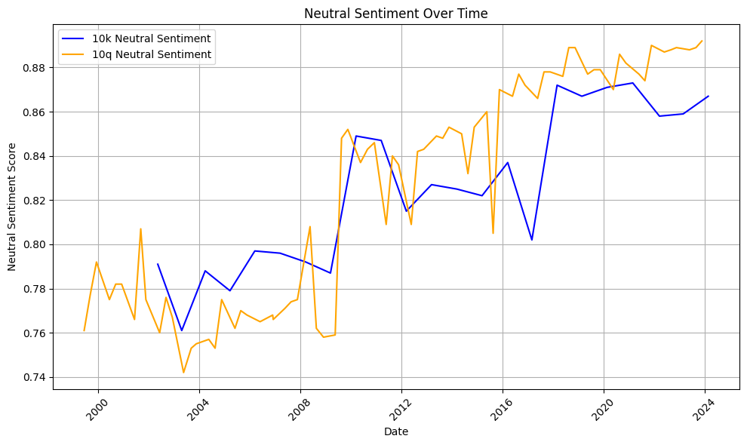
 | Negative | Neutral | Positive
Mean | 5.25% | 82.49% | 12.26%
Std dev | 2.31% | 4.69% | 3.26%
Min | 2.40% | 74.20% | 6.00%
Max | 9.20% | 89.20% | 18.50%
Highest Positive occurred on April 25th, 2003
Lowest Positive occurred on November 19th, 2009
Highest Negative occurred on May 5th, 2021
Lowest Negative occurred on August 21st, 2013

Slide 4

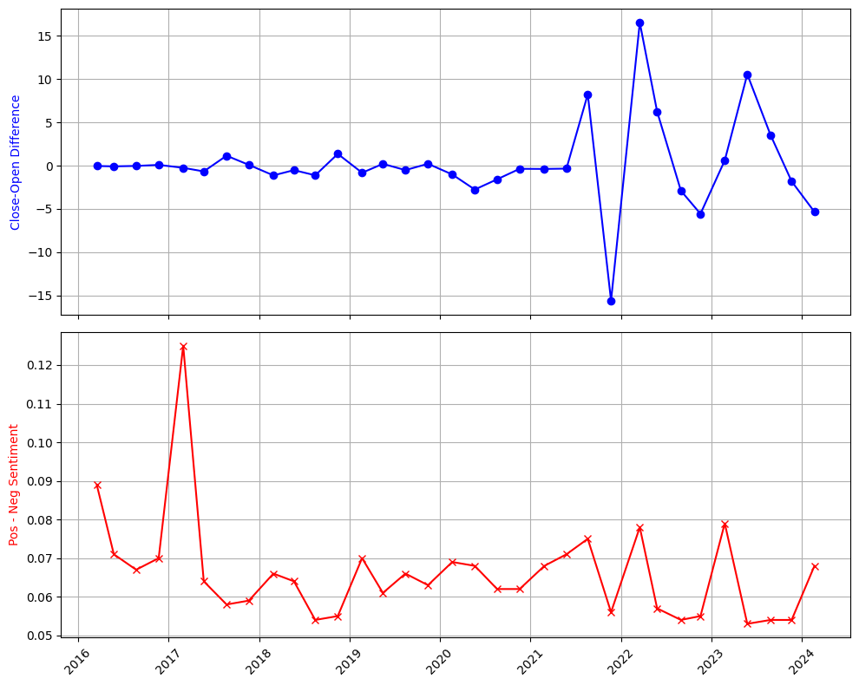
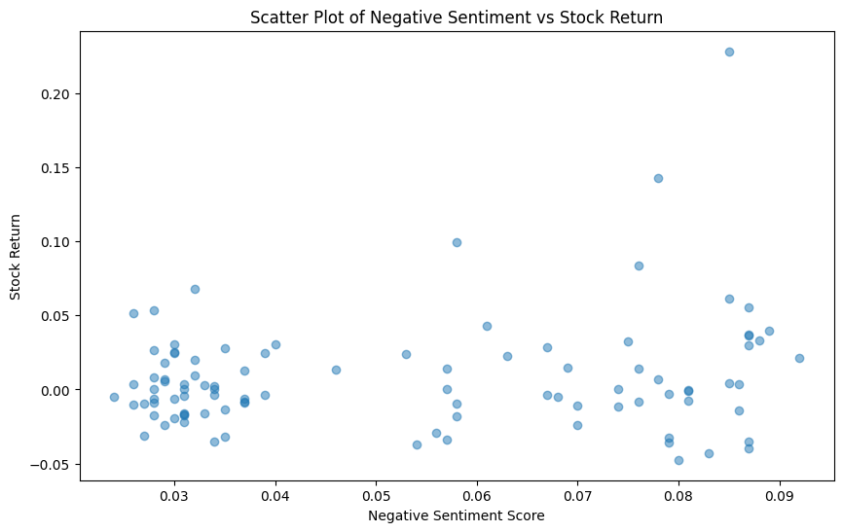
Notes:
Left Chart: Using proper dates for each 10k and 10q to match with the stock return and negative sentiment score
Charts to the right: Used this to see the effect of published 10ks, 10qs to see the impact it makes with changes to the stock price

Slide 5
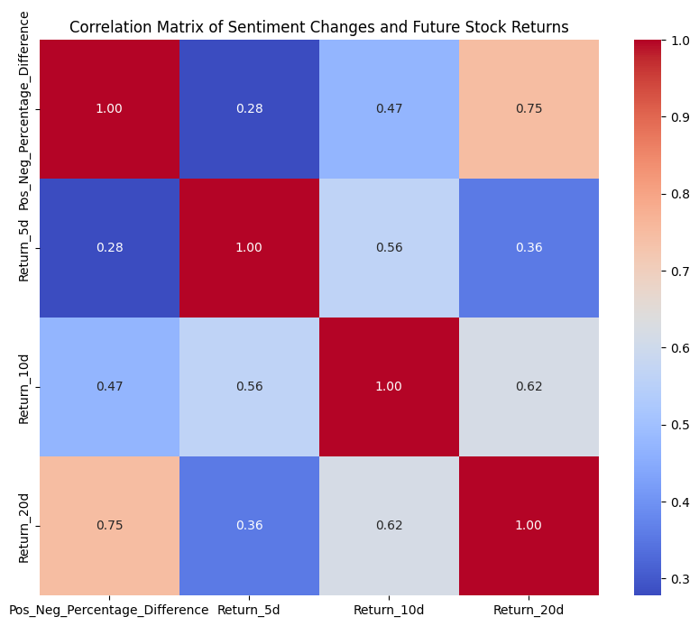
The correlation between sentiment score changes and short-term returns (5 and 10 days) is low (0.28 and 0.47)
However, after 20 trading days (one month), a stronger correlation emerges (0.75), indicating a possible delayed impact of sentiment on stock prices
This may suggest that it takes time for sentiment scores to influence stock prices, with a notable alignment occurring after 20 days
Therefore, sentiment analysis is more effective for longer-term strategies like monthly trading rather than day trading
Notes:
0.75 is significant since it could be used for predicting stock price returns. It could be possible that if takes a while for sentiment impact to hit the stock price, so the stock price is influenced over a longer period of time after the release of financial statements.
5 days and 10 days don’t look to work since impact isn’t showing any significant sentiment changes so the price will not be correlated as strongly in the future

Slide 6
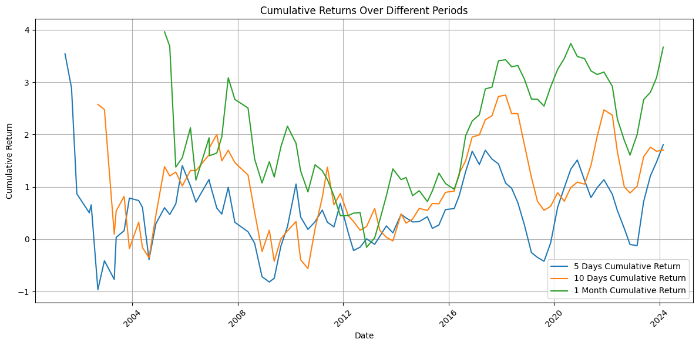

Slide 7

Conclusion
Weak correlation across all charts with it only being slightly more positive above 0.1
More positive sentiment than negative on average (12.26% > 5.25%)
The strongest correlation is found between 1 month (20 trading days) cumulative returns and sentiment change
The overall sentiment score rounded was positive with occurrences where it was negative only 8 times out 97 (8.25%)
Sentiment analysis does not appear to be as useful as we thought it could be, but more data is needed for it to be proven

